Slide 1
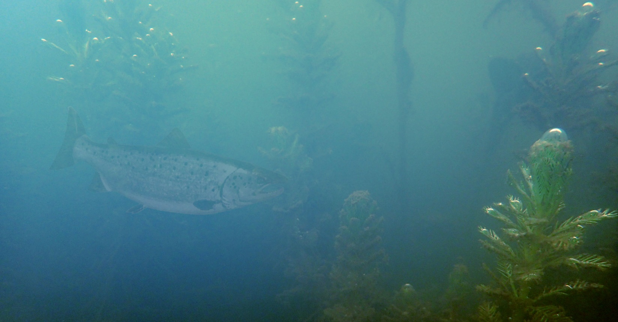

iver
rchitect
The next generation stream design
https://riverarchitect.github.io
river.architect.program@gmail.com Davis, CA | 2019

Slide 2
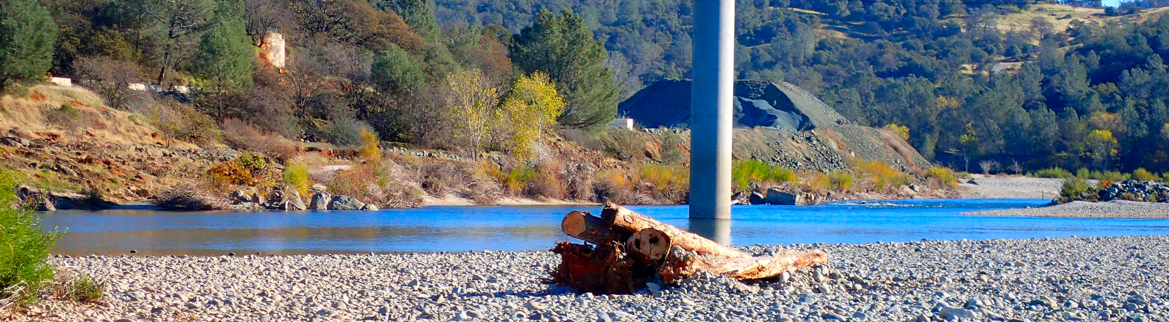
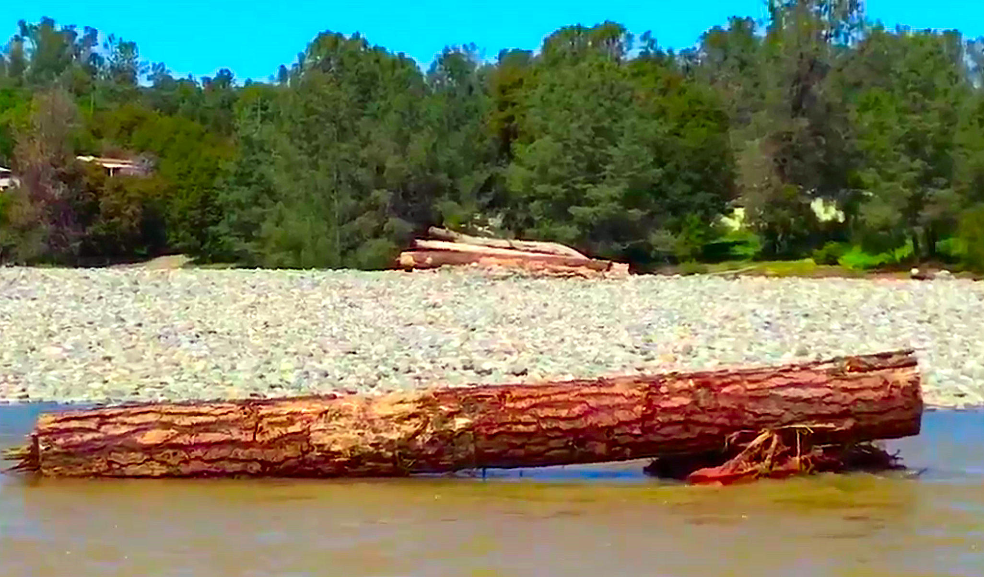
Highlights
Source: S. Schwindt
Source: Greg Pasternack @RiverSciLife
Motivation
State-of-the-Art stream design involves subjective and individual approaches that sometimes miss their objectives (ecological abundance and long-living)
Methods
Parametric and transparent design concepts
Product
Ecologically sustainable and long-living fluvial landscapes with economic assessment
Introduction
Concept

Slide 3
Highlights
Lifespan & Design Mapping
Longevity assessments of single features
Morphology
Terrain modification to yield self-sustaining fluvial landscapes and mass movement assessments
Ecohydraulics
Habitat quality and connectivity assessment for target species and their lifestages
Project Maker
Presentation-ready wrap up of project costs and benefits
Introduction
Modules

Slide 4

Lifespan & Design Mapping.

Slide 5
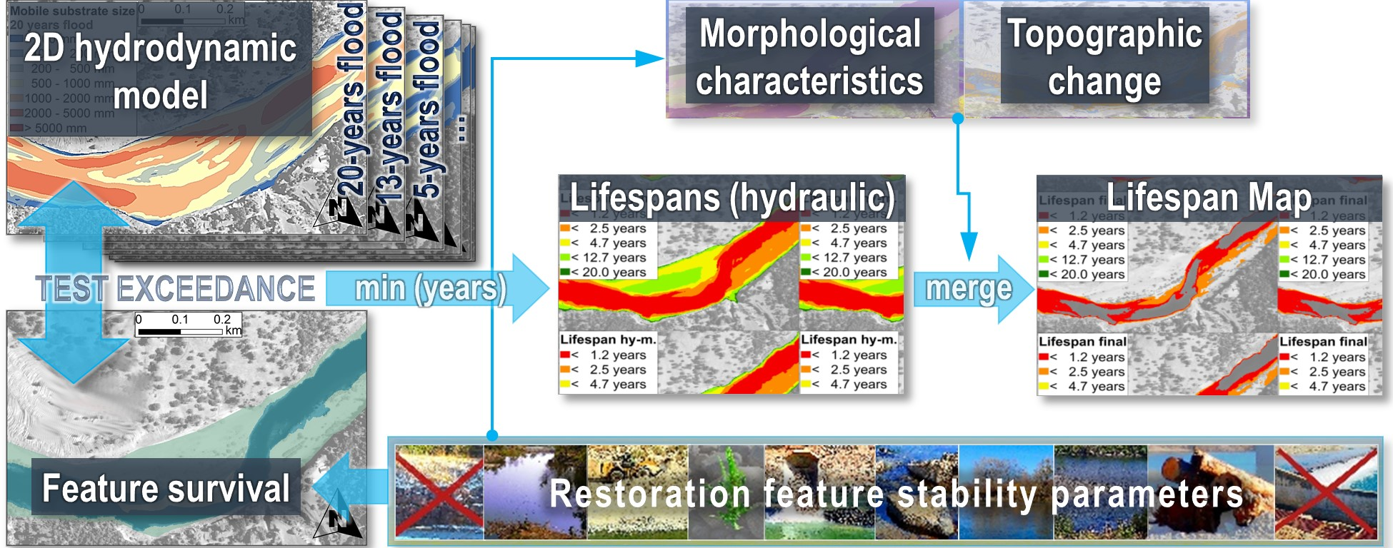
Lifespan mapping
Source: Schwindt, S., Pasternack G. B., Bratovich, P. M., Rabone, G., Simodynes, D. , 2019. Hydro-morphological parameters generate lifespan maps for
stream restoration management. Journal of Environmental Management 232, 475-489. doi: 10.1016/j.jenvman.2018.11.010
River Architect
Methods

Slide 6
Lifespan mapping
Input
Flow data

Slide 7
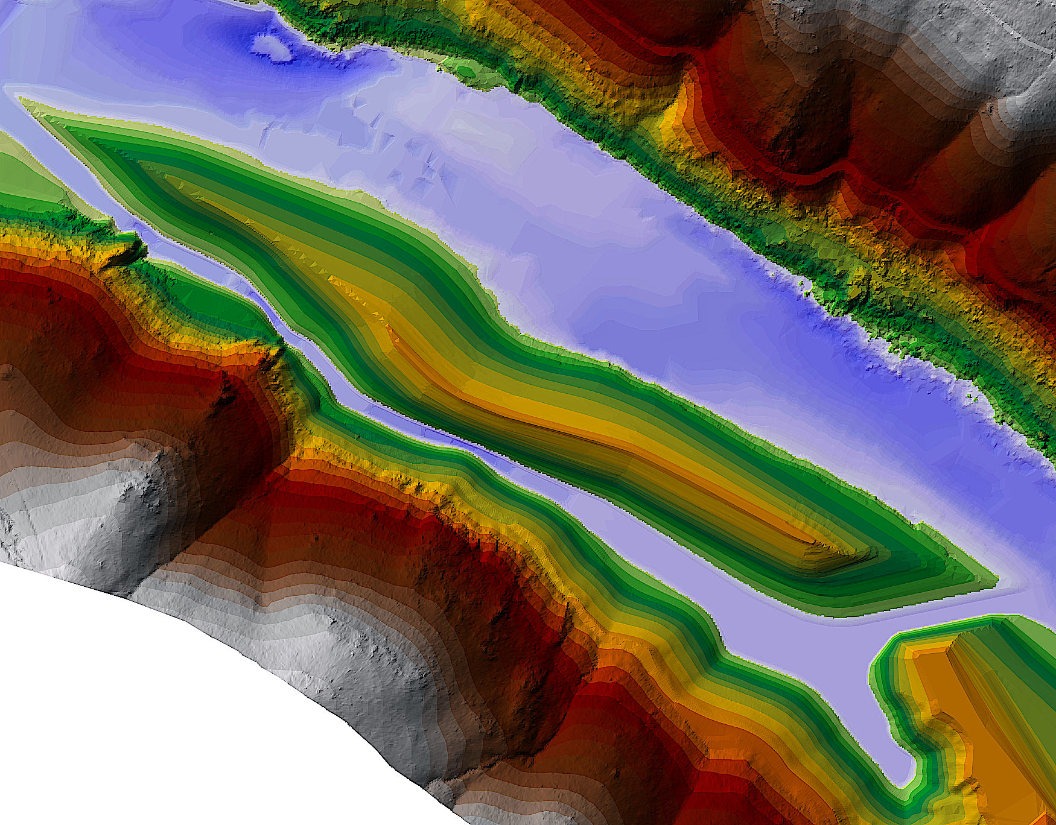

Lifespan mapping
Digital
Elevation
Model
Grain sizes
2D hydrodynamic modelling
(depth, velocity)
Morphological Units (instream)
Detrended DEM
Depth to Groundwater
Input
Rasters

Slide 8
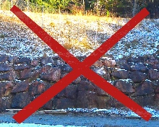
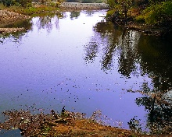
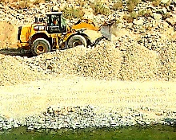
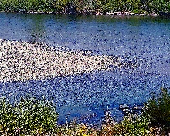
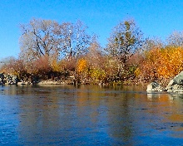
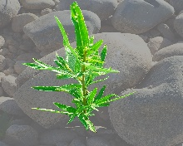
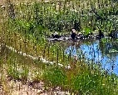
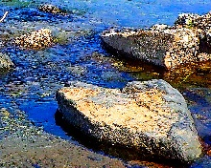
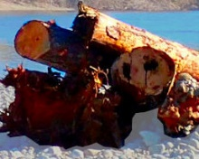
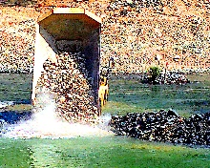
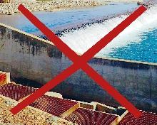
Features
Stream design feature groups
Parametrization: Survival threshold values
GROUP 1: Berm setback, calm water zones, grading, side channels, bank scalloping
GROUP 2: Vegetation plantings &
other (soil) bioengineering
GROUP 3 – Longitudinal connectivity: Sediment budget modification,
flow regulation, lateral barrier removal
(not yet fully considered in River Architect)
Parameter (unit) | Depth to ground water (m) | Dim.less bed shear stress (--) | Froude number (--) | Flow depth (m) | Flow velocity (m/s) | TCD: Fill (m/year) | TCD: Erosion (m/year)
Grading | 2 - 4 | 0.047 | na | na | na | na | 0.01
Etc. | … | … | … | … | … | … | …
Introduction
Features

Slide 9
Lifespan mapping
Sustainability Criteria – Thresholds
Source: https://github.com/RiverArchitect/program/blob/master/LifespanDesign/.templates/threshold_values.xlsx
Methods

Slide 10
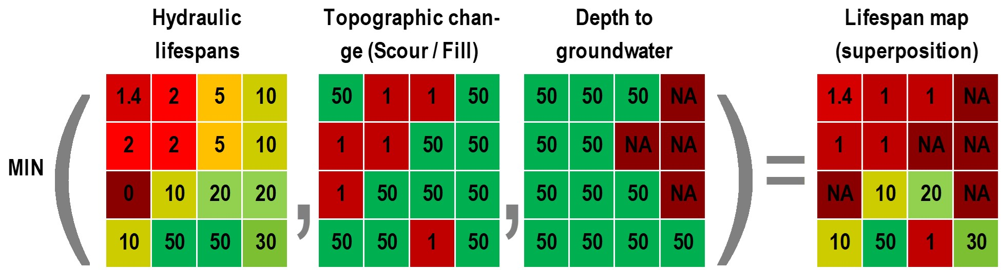
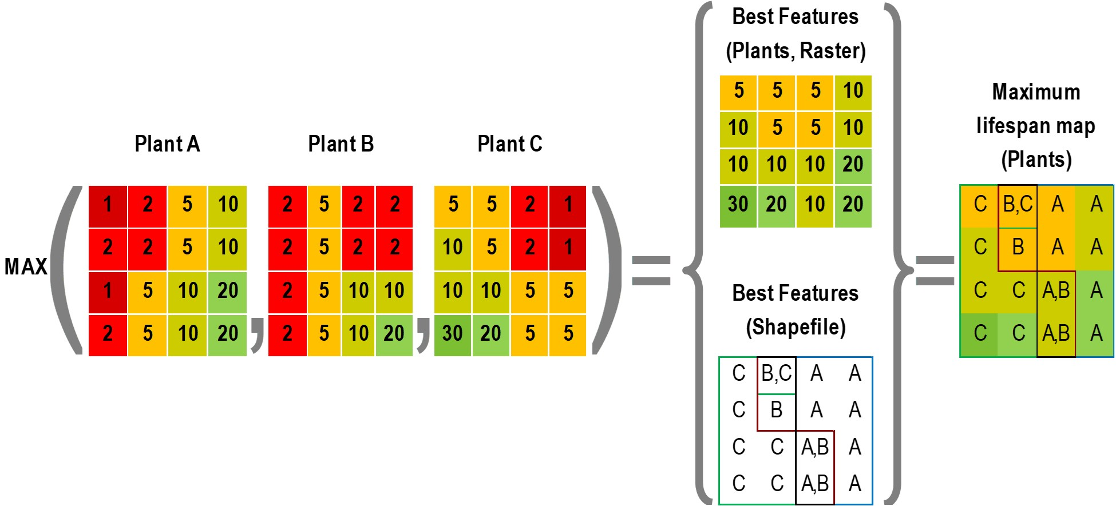
Lifespan mapping
Lifespan Calculation (Raster overlay)
Identify best lifespan within feature groups
Source: Schwindt, S., Pasternack G. B., Bratovich, P. M., Rabone, G., Simodynes, D. , 2019. Under preparation
Lifespan mapping
Calculous

Slide 11
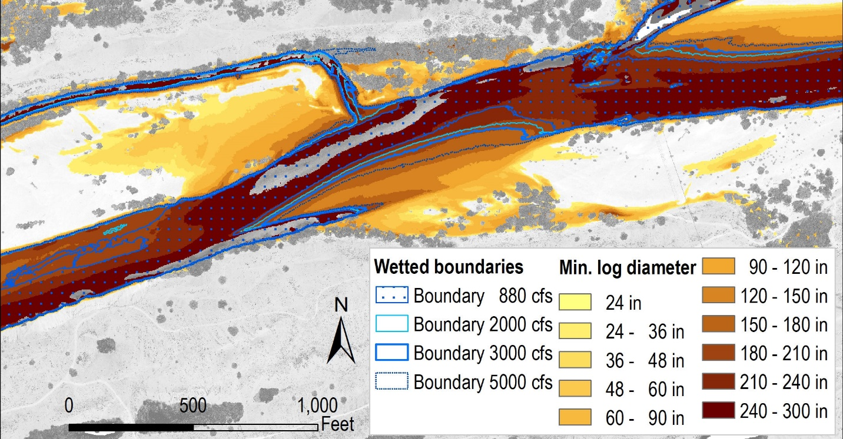
Lifespan mapping
Example: Identify stable log diameters for streamwood placement
Lifespan mapping
Design maps

Slide 12
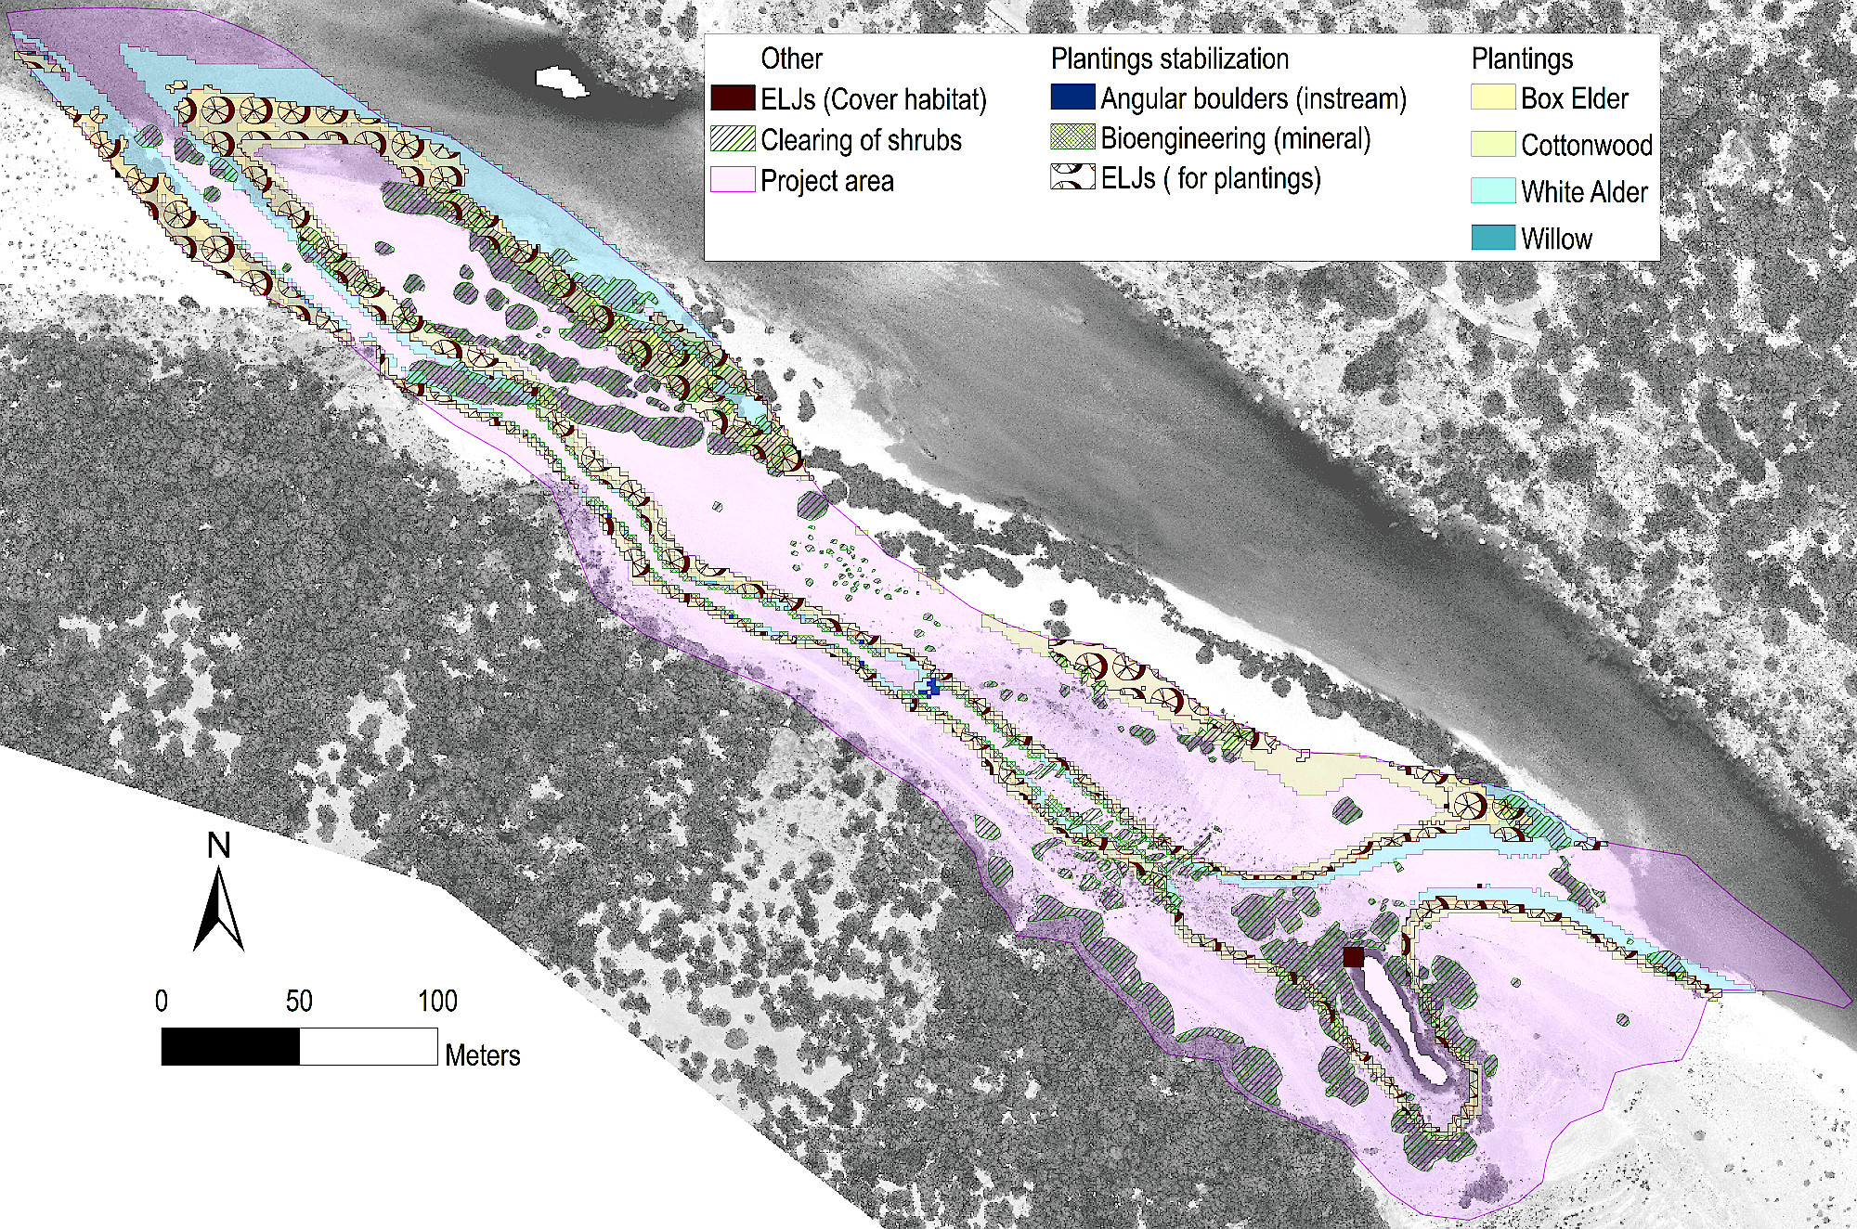
Lifespan mapping
Result processing
Use for planning terraforming actions: Manual action required
Use for full-automated planning of vegetation plantings & other bioengineering features
And more …
… gravel augmentation
… streamwood
… mass movement
Lifespan mapping
Results

Slide 13
Morphology.

Slide 14
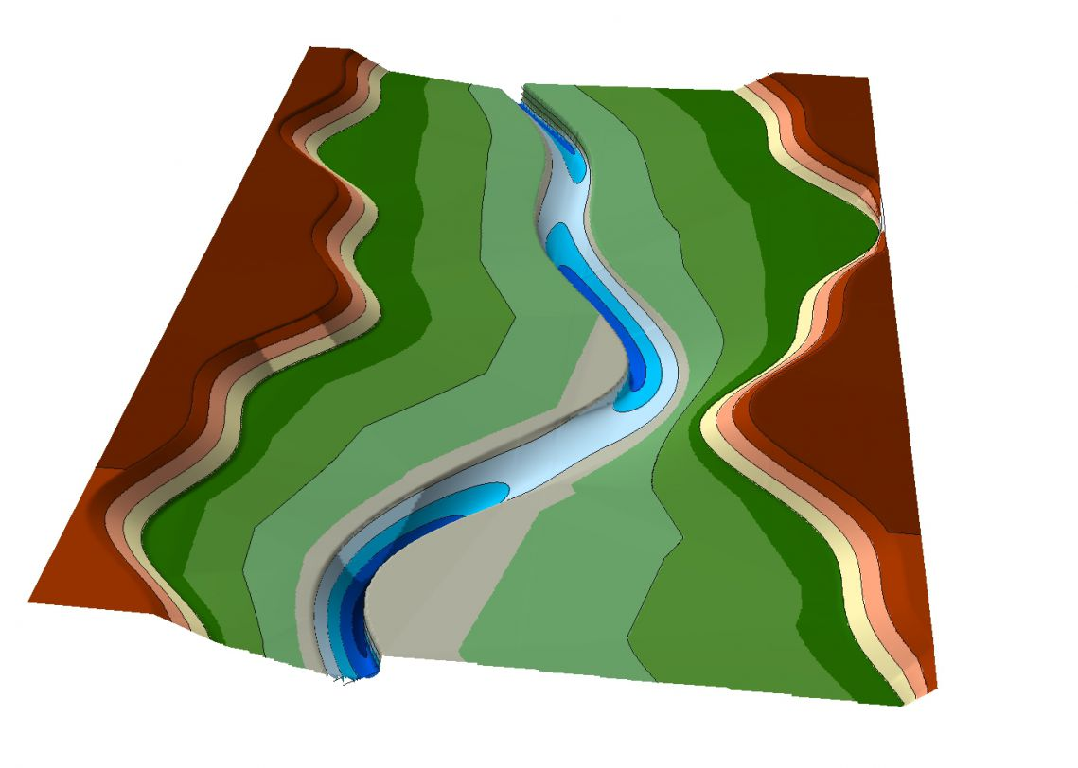
Morphology
Use Threshold-based terraforming or River Builder to design riverscapes
Threshold-based terraforming: Grading or River widening
River Builder
Volumetric Terraforming assessment
… these routines procedualize
currently best available science
… we are developing new strategies
to improve procedural terraforming
based on physical boundary conditions
Synthetic river valley created with River Builder
(source: Gregory B. Pasternack)
Morphology
Overview

Slide 15
Ecohydraulics.

Slide 16

Ecohydraulics
Habitat assessment (1): Habitat Suitability Index (HSI) of juv. Chinook salm.
Combined HSI (cHSI) = $\sqrt{DHSI·VHSI}$
VHSI (Velocity)
DHSI (Depth)
Source: Schwindt, S., Pasternack G. B., Bratovich, P. M., Rabone, G., Simodynes, D. , 2019. Under preparation.
Habitat
Define Fish

Slide 17
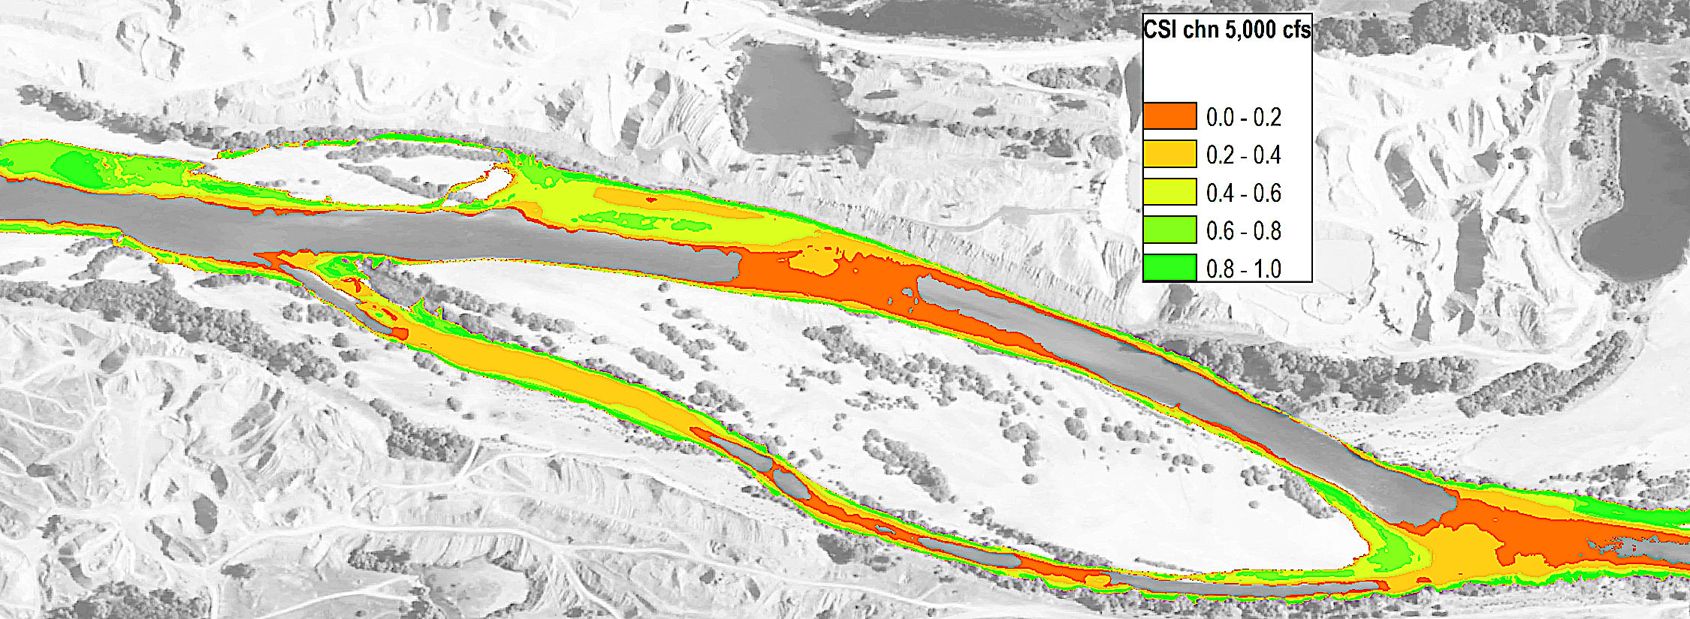
Ecohydraulics : Habitat Enhancement
Habitat assessment (2): composite Habitat Suitability Index (cHSI) map
Repeat operation for multiple discharges (apply flow duration curve)
Calculate usable habitat area (e.g., cHSI > θ = …)
Usable Area
Source: Schwindt, S., Pasternack G. B., Bratovich, P. M., Rabone, G., Simodynes, D. , 2019. under preparation
Habitat
Methods

Slide 18
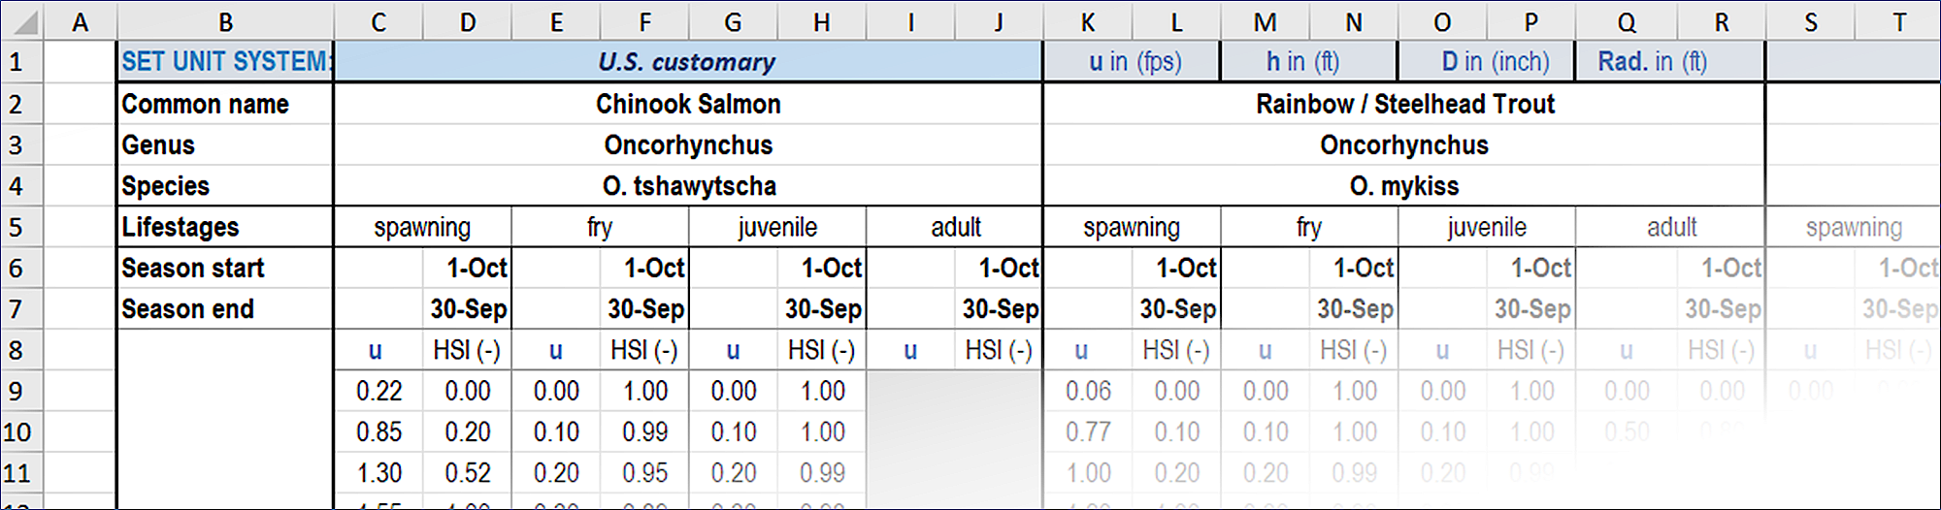
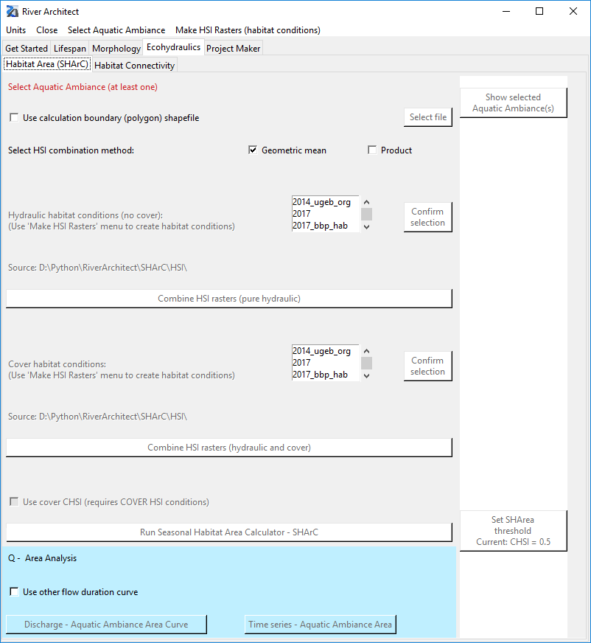
Ecohydraulics: Habitat Enhancement
Fish preferences in River Architect
Usable habitat is where θ = …
Habitat
Define Fish

Slide 19
Ecohydraulics: Habitat Enhancement
Habitat assessment (2): composite Habitat Suitability Index (cHSI) map
Repeat operation for multiple discharges (apply flow duration curve)
Calculate usable habitat area (e.g., cHSI > θ = …)
Sum of usable areas for one discharge = SHArea
Sum of multiple season-specific discharges = Seasonal Habitat Area (SHArea)
Usable HabitaArea
Source: Schwindt, S., Pasternack G. B., Bratovich, P. M., Rabone, G., Simodynes, D. , 2019. Under preparation.
Habitat
Methods

Slide 20
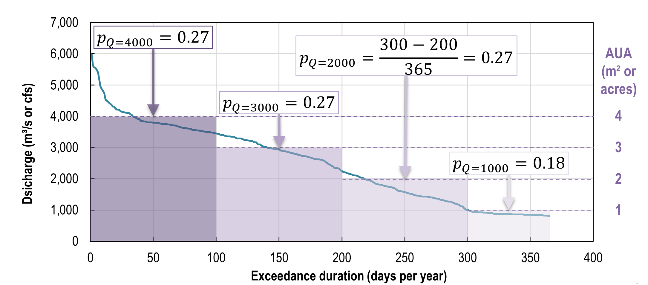

Ecohydraulics: Habitat Enhancement
Habitat assessment (3): Calculate Seasonal Habitat Area (SHArea)
$$SHArea=\sum_{p_{Qi}}^{p_{Qn}}{\left[\sum{pixels\left(cHSI> θ\right)}\right]}∙p_{Qk}$$
… and season
More: https://riverarchitect.github.io/RA_wiki/SHArC#herunSHArea
Habitat
Methods

Slide 21
Project Maker (Cost-Benefit Analysis).

Slide 22
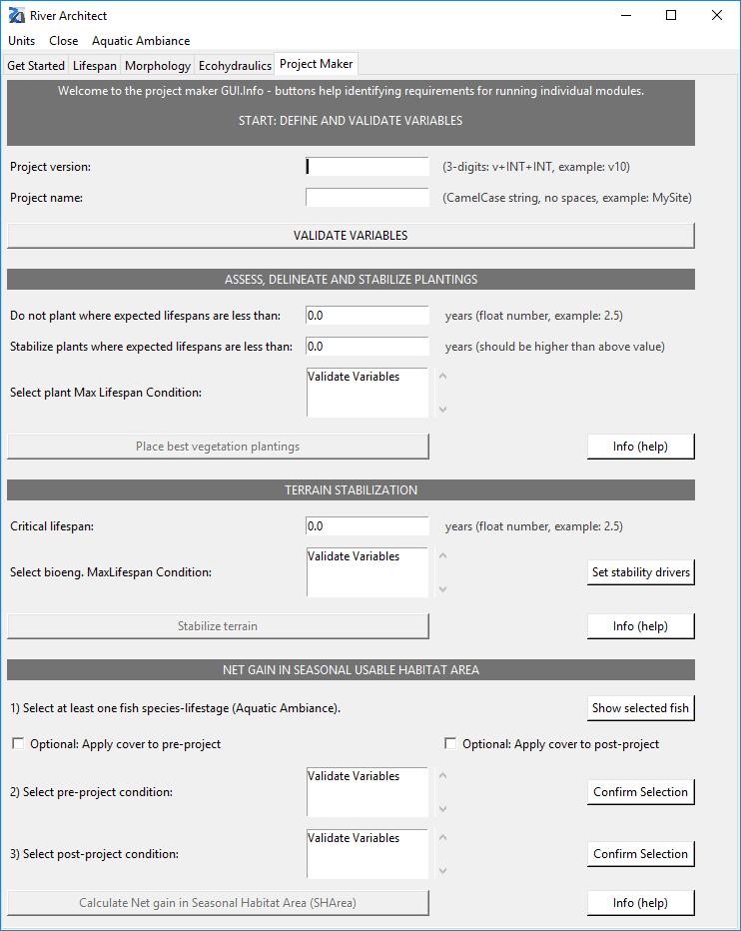
Project Maker
Site-wise metrics
Automated terraforming assessment
Automated vegetation plant-ings & other bioengineering placement
Automated cost assessment
Projekt Maker
Input

Slide 23
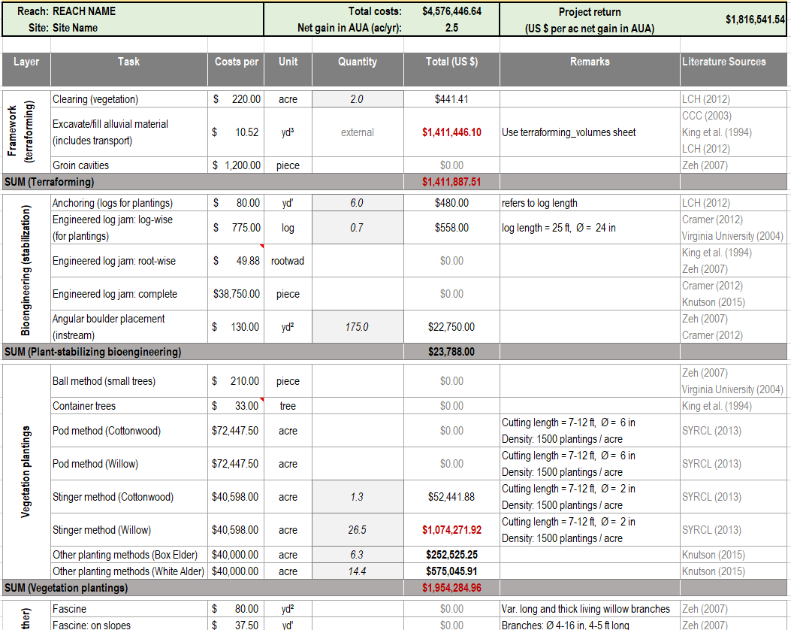
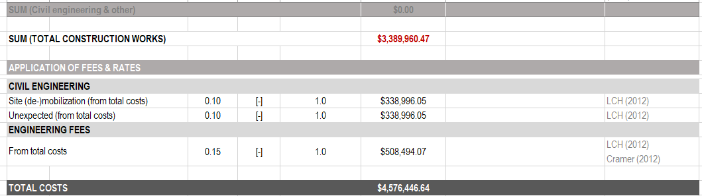
Project Maker
… Project key metrics
Projekt Maker
Output

Slide 24
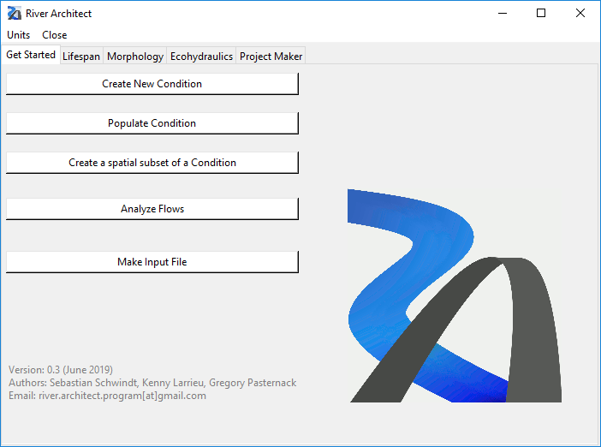
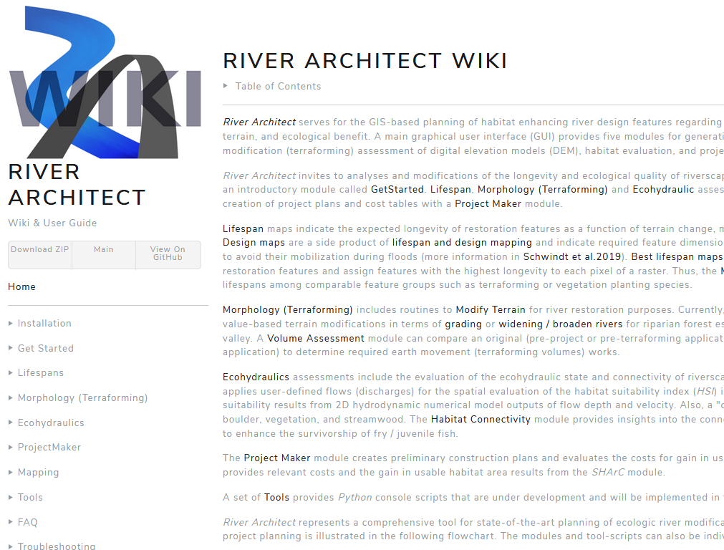
Highlights
download https://sschwindt.github.io/RiverArchitect/
docu https://github.com/sschwindt/RiverArchitect/wiki
maintenance S. Schwindt, K. Larrieu, G. Pasternack
Reference: Schwindt, S., Pasternack G. B., Bratovich, P. M., Rabone, G., Simodynes, D. , 2019. Under preparation

